Slide 1






Smart Traffic Management Using Deep Learning
Team Id- 6451
Rahul K Shah
Aadil Tansawala
Smit Patel
Vedanshu Sharma
Nishant Prajapati
Notes:
1

Slide 2



PROJECT OBJECTIVES
PROBLEM STATEMENT
PROJECT OVERVIEW – INTRODUCTION
END USERS
WOW FACTOR IN PROJECT
BLOCK DIAGRAM
RESULT/OUTCOMES
CONCLUSION
FUTURE PERSPECTIVE

Slide 3



PROBLEM STATEMENT
Revolutionize traditional traffic management with an advanced system integrating deep learning object detection and real-time analysis. The project addresses the pressing need for efficient traffic management systems capable of mitigating congestion and ensuring smoother commuting experiences.

Slide 4
WHY THIS PROJECT ?
Addressing urbanization challenges by optimizing traffic flow with dynamic solutions.
Introducing adaptive traffic management systems to minimize inefficiencies.
Improving resource efficiency by replacing static approaches with dynamic ones.
Making a global impact on efficient traffic management through advanced technologies.

Slide 5
PROJECT OVERVIEW - INTRODUCTION
What's All the Buzz About?
Harnessing cutting-edge technologies, we're redefining traditional approaches, embracing dynamism and adaptability.
Project Focus:
Urbanization and population growth strain traffic management; static methods lead to congestion and inefficiencies, wasting resources..

Slide 6


TECHNICAL DILEMMA
Vs

Slide 7
OUR PROPOSED SOLUTION
This project addresses urbanization challenges by offering dynamic traffic solutions, optimizing resource efficiency globally.
Real-time Object Detection! Implementing deep learning models for real-time vehicle detection within traffic streams.
Dynamic Traffic Flow Optimization! Utilizing data analysis to predict and adjust traffic patterns for enhanced efficiency.
Intelligent Token Passing Mechanism! Employing a token-based system to prioritize vehicle flow, especially for emergency vehicles.

Slide 8
END USERS
Traffic authorities and city planners responsible for managing roadways and ensuring efficient traffic flow.
Commuters and drivers seeking smoother and safer travel experiences on urban roads.
Emergency service providers requiring swift and unobstructed access to incidents and accidents.
Urban planners and policymakers interested in leveraging technology to improve transportation infrastructure and city planning.

Slide 9
WOW FACTOR IN SOLUTION
Alleviate congestion by optimizing traffic flow and reducing travel times.
Enhance safety measures to minimize road accidents and ensure safer roadways.
Embrace technological solutions to develop smarter traffic management systems for modern urban environments.
Accident Detection and following with due procedures.

Slide 10
OUR GOAL
Cutting-edge tech: Utilize Deep learning algorithms analyze real-time traffic data for optimal flow.
Safety first: By enabling Proactive measures prevent accidents, ensuring safer journeys.
Smooth rides: Dynamic adjustments minimize delays, reducing travel times.
Eco-friendly: Efficient management lowers fuel consumption and emissions.
Global solution: Addresses urban congestion for smoother, safer, and sustainable cities.

Slide 11
CODE & IMPLEMENTATION

Slide 12
WORKING
INITIAL
FUNCTION
There are 4 lanes:
1ˢᵗ lane is open
2ⁿᵈ assigned X sec timer
3ʳᵈ assigned STOP
4ᵗʰ assigned STOP
When 1ˢᵗ lane opens and it will trigger function which will analyse traffic of 2ⁿᵈ lane ,Using open CV and STOP lane.
This function will return value X’ which will assign to 3ʳᵈ lane timer & Repeat.
Function- Assign time (sec) according to vehicle spotted .
Min-max value to avoid assigning insufficient time.

Slide 13







0 s
5 +5 s
5 +3 s
5s
8

Slide 14
5+5+3 s
5 s
0s
5
5 s

Slide 15
THE CODING PART
Different languages we used in our project and why did we chose those technologies :
Python
YOLO
Open CV
Versatile
Real Time Object Detection
Computer vision tools
Readable
Timely detection of vehicles
image processing
Scalable
System efficiency
video analysis
Community-driven
Adaptive
traffic management algorithms

Slide 16
IMPLEMENTATION AND DEPLOYMENT
Collaboration with local authorities and traffic agencies.
Installation of cameras at strategic locations.
Integration with existing traffic management infrastructure.
Educating user for new system, analysis and benefits

Slide 17
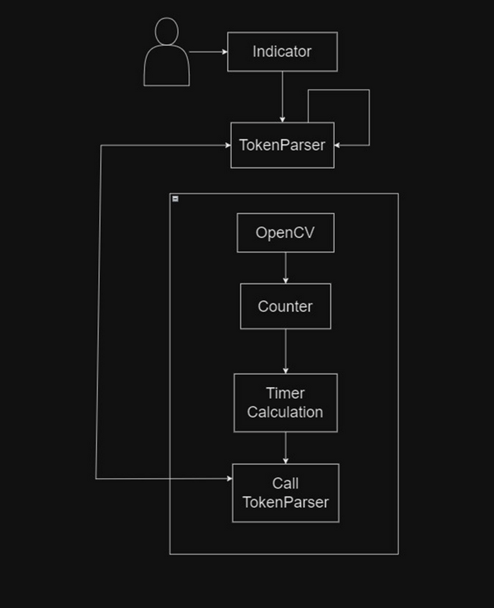
BLOCK DIAGRAM

Slide 18

Enough with all the gibber-gabber and finally here is the first look of our Project

Slide 19
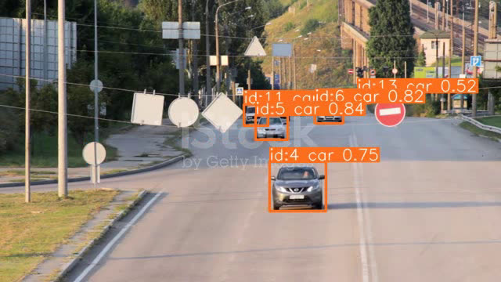

Slide 20
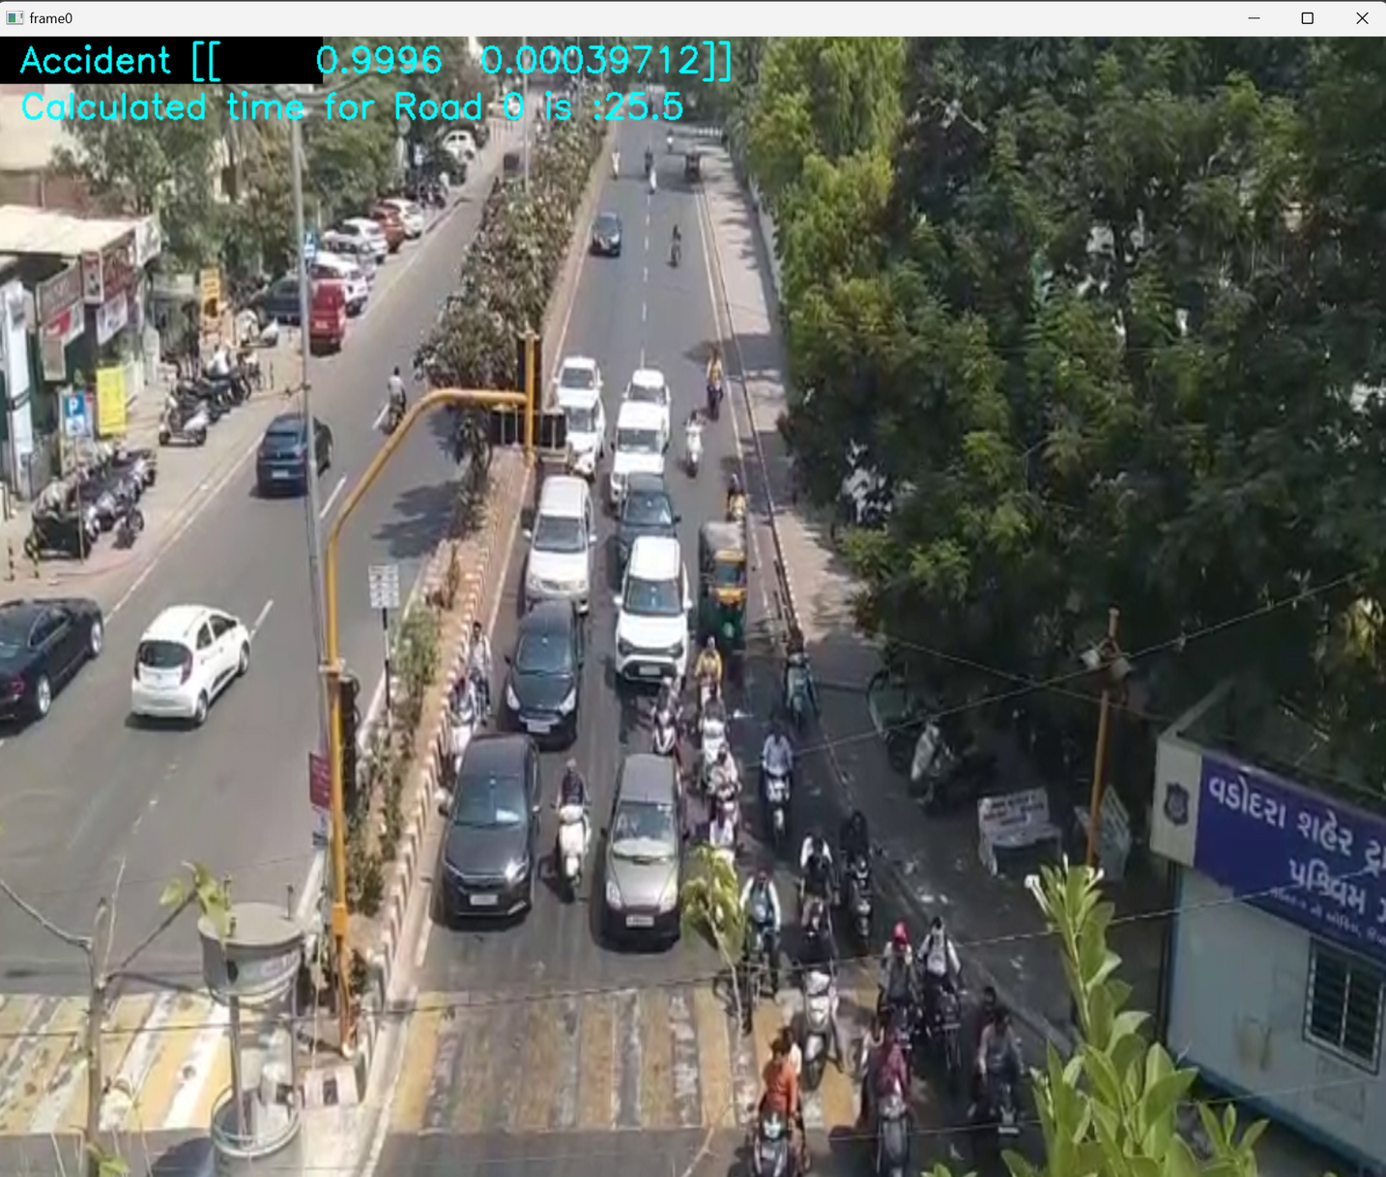

Slide 21
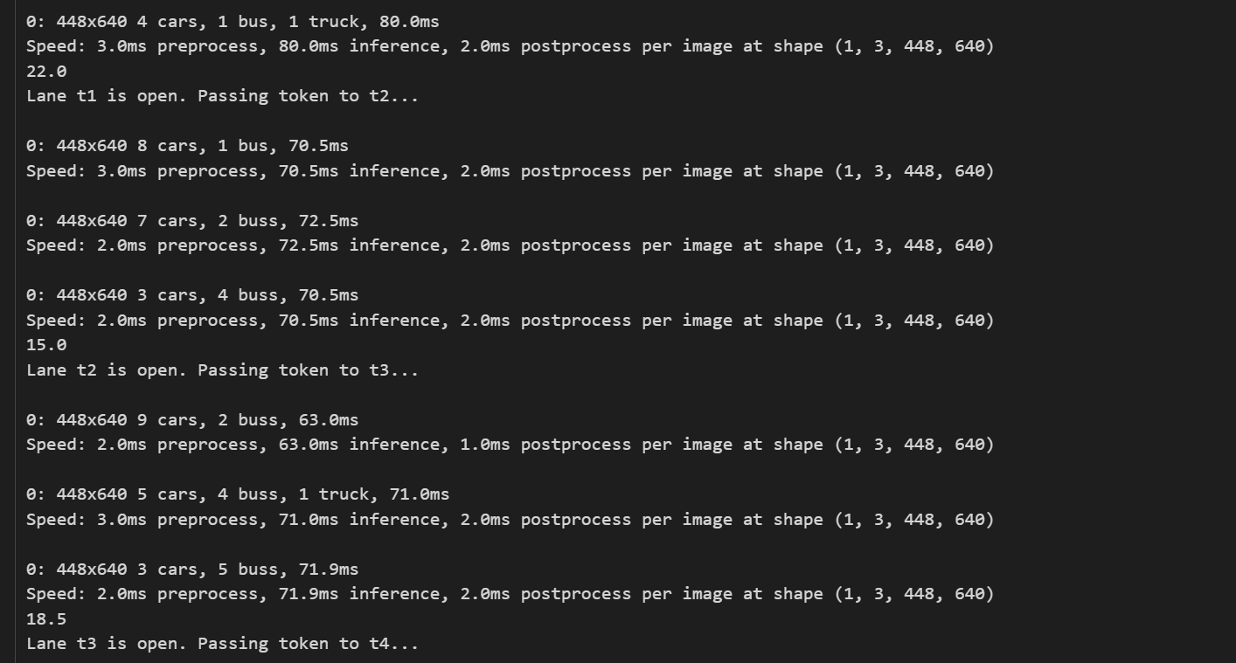
RESULT / OUTCOMES

Slide 22
FUTURE OUTLOOK
There are two implementation which we are seeking and thinking to add upon which are as follows:
AMBULANCE SAFETY: Here , in this project, we can only detect the first three - four rows so depending upon that we seek to increase the detection area so that the ambulance can easily be detected and pass the signal and the life can be saved.
SPEED Detection and chalan : It will detect and send warning for over speeding and if user exceeds limit of warning it will generate E-chalan for registered vehicle

Slide 23
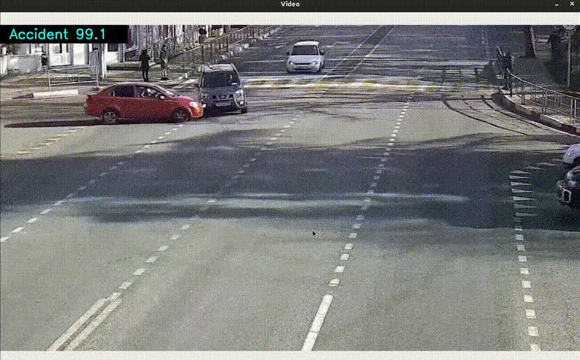
ACCIDENT DETECTION

Slide 24
SUMMARY
Concluding this presentation we would like to summaries it all because, why not ?!!
1
Key Points
Efficiency, Safety, Adaptability
2
Value Proposition
Enhanced traffic management.
3
Impact
Enhanced road safety.

Slide 25

CONCLUSION
In conclusion, developing this innovative traffic management system has been an exhilarating journey.
We trust that our efforts will significantly impact road efficiency and safety, and we're excited to witness the positive transformations.
Thank you for joining us on this remarkable journey, and we eagerly anticipate the continued evolution and success of our traffic management solution.

Slide 26
Q&A SESSION:

Slide 27
THANK YOU

